Slide 1
Tips to increase physical activity across the school day

Slide 2
Notes:
Really lucky in Yorkshire to be at the forefront of the PA movement with lots of really good and affordable resources.
Think about using SP money to invest in resources and training that will enhance your active curriculum, and provide sustained impact.

Slide 4
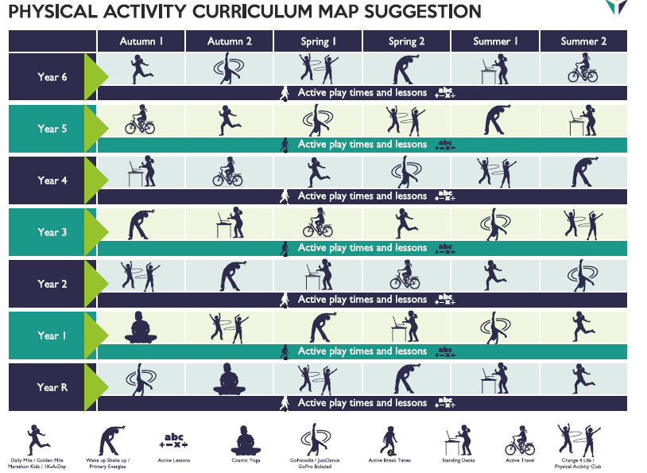
Notes:
Yorkshire sport foundation Daily Physical activity planner

Slide 5
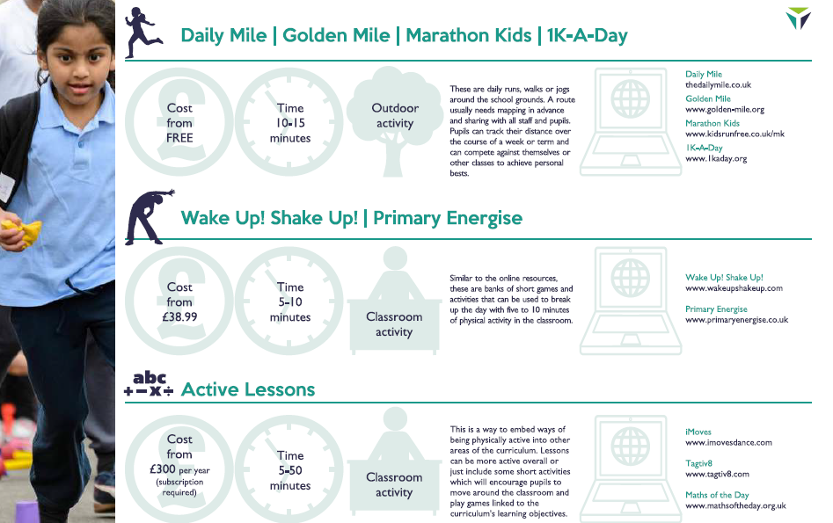

Slide 8
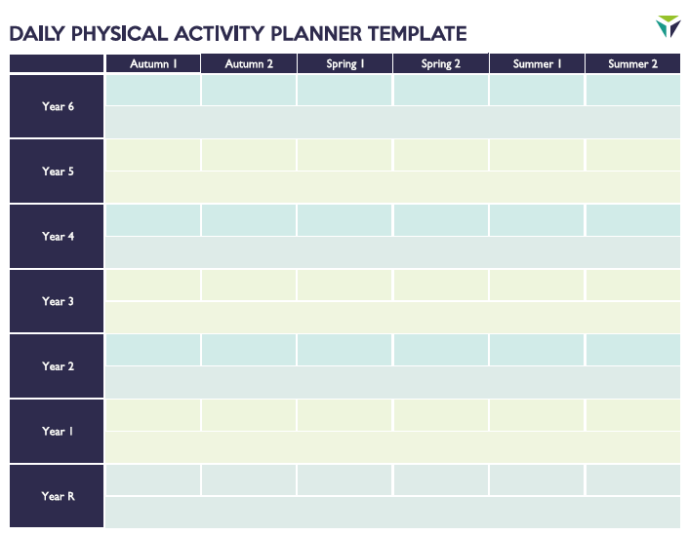

Slide 9
Activity Alarm
Select one student alarm leader each day/week to be in charge.
At selected times each day 10am / 2pm – they ring a bell which indicates the whole class stands up behind their desk to do a 5/10min activity –led by the alarm leader.
Activities can include passing a ball around the class – using a counting order.
Balances
A dance (could be a gonoodle video/ WUSU).
Simon says
Head shoulders knees and toes
Mexican wave
Floss / baby shark
Stretches

Slide 10
Themed activity weeks
Skoot / walk / cycle to and from school.
Wake up shake up every break time/ before /after assembly
Daily mile week
Any more?
Have you tried any? Discuss if these would work in your school?
Could any kick start a new school routine.

Slide 11
Train like a Jedi Video

