Slide 1
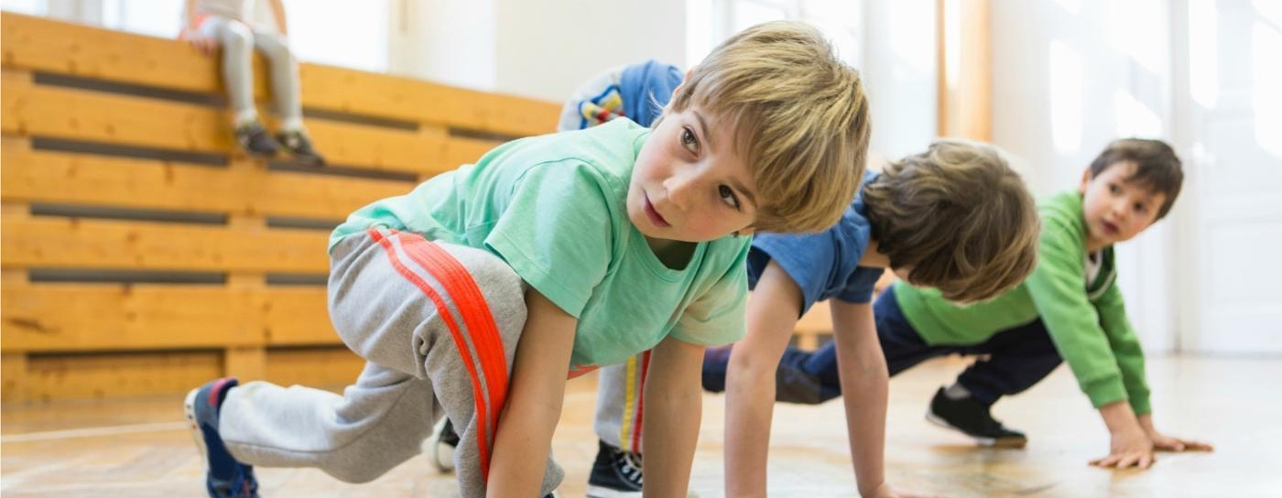
Sixty Active Minutes for Every Child, Every Day
Providing 30 active minutes in school
Influencing 30 active minutes beyond school
Notes:
Course description:
The local engagement event will support schools to increase physical activity throughout the school day to boost health and academic achievement for their students. It looks at how schools can:
meet the requirements of the government’s childhood obesity plan
develop their understanding of the evidence and research underpinning active approaches in schools
learn how to use the free Active School Planner to increase daily activity and reduce sitting time for every child
explore solutions to boost wellbeing and achievement by building 30 active minutes of physical activity into the whole school day and influencing 30 active minutes beyond the school day.
Outcomes:
By the end of the workshop, delegates should be able to:
advocate why high levels of physical activity across the school day lead to healthier and more effective learners
reflect on how effective their current provision is at promoting physical activity throughout the school day
know how to reduce sedentary behaviour and embed physical activity in their school
plan their journey to becoming an Active School

Slide 2
The Challenge
Available at www.activeschoolplanner.org
Notes:
The challenge, as presented by the Childhood Obesity Plan for Action

Slide 3
The Challenge
Nearly a third of children aged 2 to 15 are overweight or obese
Younger generations are becoming obese at earlier ages and staying obese for longer
Notes:
The challenge, as presented by the Childhood Obesity Plan for Action

Slide 4
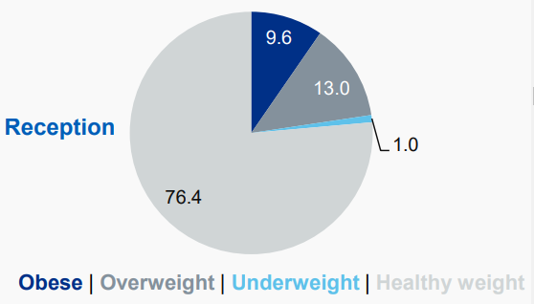
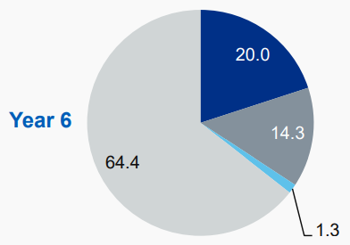
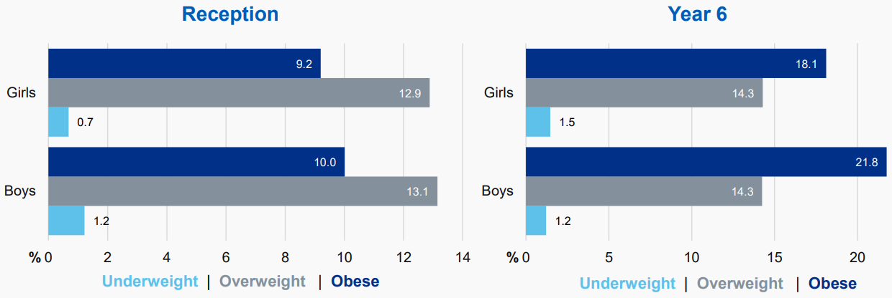
The Challenge
National Child Measurement Programme, England, 2016/17 school year
Notes:
National Child Measurement Programme, 2016-17 school year: Latest Findings
Age
Obesity prevalence was more than twice as high in year 6 (20.0%) compared to reception (9.6%).
The proportion of underweight children was higher in year 6 (1.3%) than in reception (1.0%).
Around three quarters of reception children were healthy weight (76.4%). In year 6 it was around two thirds (64.4%).
Gender:
The difference in obesity prevalence between boys and girls was larger in year 6 than reception.
Underweight prevalence was higher for boys in reception but higher for girls in year 6.
More details can be found at:
http://digital.nhs.uk/catalogue/PUB30113

Slide 5
The Challenge
Obesity doubles the risk of dying prematurely

Slide 6
Available at www.activeschoolplanner.org

Slide 7
Module One: The Context
www.gov.uk/government/publications/childhood-obesity-a-plan-for-action
Notes:
We’ve seen the challenge to individuals and society as a whole. What resources, support and accountability measures will be provided to support schools in helping to address the obesity epidemic?

Slide 8
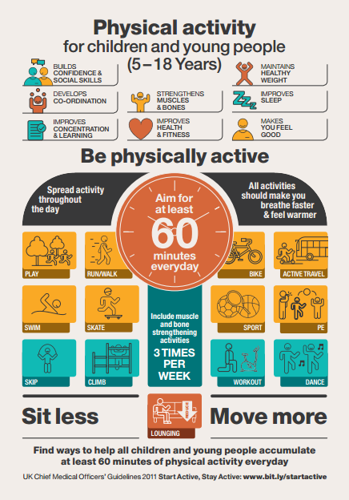
The Role of Schools
Every primary school child should get at least 60 minutes of moderate to vigorous physical activity a day
At least 30 minutes should be delivered in school every day
www.gov.uk/government/uploads/system/uploads/attachment_data/file/541231/CYP_infographic.pdf
Notes:
CMO recommendations

Slide 9
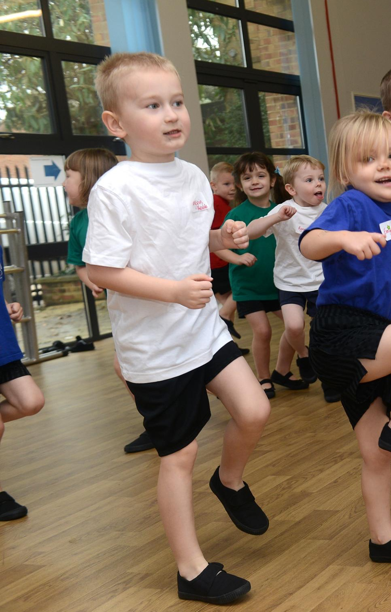
Task One
What has your school already done to address this challenge?
What else do you need to do?

Slide 10
Monitoring the Impact
Ofsted assess how school leaders use the Primary PE and Sport Premium and its impact
Ofsted will conduct a thematic review on obesity, healthy eating and physical activity, with examples of good practice and recommendations on what more schools can do

Slide 11
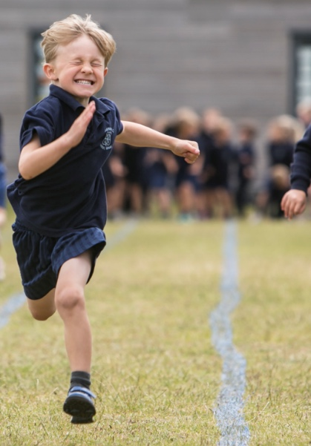
Task Two
How well prepared is your school to demonstrate the impact on health outcomes of primary sport funding?
What else do you need to do?

Slide 12
Module Two: Benefits of a more active school
Available at www.activeschoolplanner.org

Slide 13
The Evidence: A Rapid Summary
www.gov.uk/government/publications/the-link-between-pupil-health-and-wellbeing-and-attainment

Slide 14
Key Points for Schools
Pupils with better health and wellbeing are likely to achieve better academically
The link between pupil health and wellbeing and attainment
A briefing for head teachers, governors and staff in education settings
Public Health England, 2014

Slide 15
Key Points for Schools
Effective social and emotional competencies are associated with greater health and wellbeing, and better achievement
The link between pupil health and wellbeing and attainment
A briefing for head teachers, governors and staff in education settings
Public Health England, 2014

Slide 16
Key Points for Schools
The culture, ethos and environment of a school influences the health and wellbeing of pupils and their readiness to learn
The link between pupil health and wellbeing and attainment
A briefing for head teachers, governors and staff in education settings
Public Health England, 2014

Slide 17
Key Points for Schools
A positive association exists between academic attainment and physical activity levels of pupils
The link between pupil health and wellbeing and attainment
A briefing for head teachers, governors and staff in education settings
Public Health England, 2014

Slide 18
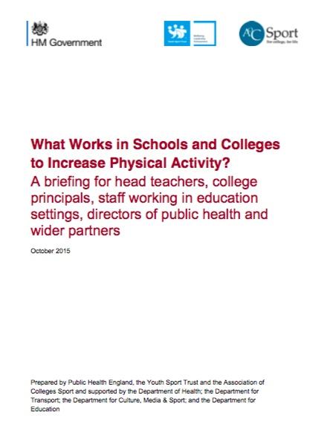
www.gov.uk/government/publications/what-works-in-schools-to-increase-physical-activity-briefing
www.designedtomove.org

Slide 19
Module Three: Building a more active school
www.activeschoolplanner.org
Notes:
www.activeschoolplanner.org

Slide 20
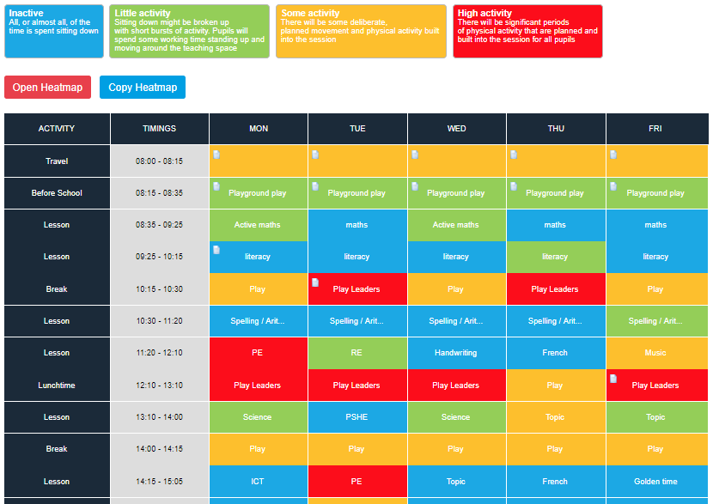
www.activeschoolplanner.org
#YSTActiveSchool
Notes:
The principle tool of the site is the activity heatmap. This is the self-review tool to help schools map current activity levels, plot the colder areas and begin to plan ways to increase activity levels at times in the school timetable. Further detail on the activity heatmap tool:
A school/user will need to modify the heatmap template when they first use the site to ensure it reflects the school timetable
Future heatmaps can then be copied to save the user having to repeat this process. However, they can start from scratch if required
Users reflect on practice and plot activity levels based on the scale specified. If the activity level is the same for a period all week, then the user can select ‘apply to all days’
Users can upload evidence/files/ images etc to periods of the school timetable. Evidence can be shared publicly and it will show in the Physical Activities Library
The most recent heatmap completed by the user will always show first
Once a heatmap is completed click ‘finish heatmap’

Slide 21
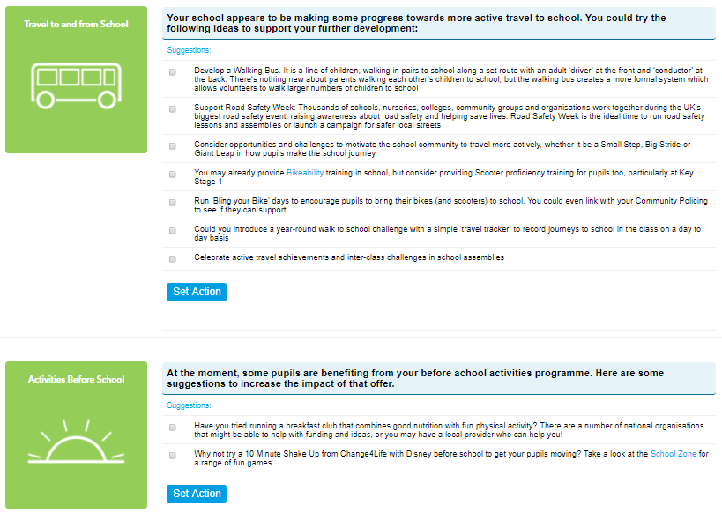
Action Planning
www.activeschoolplanner.org
Notes:
Action Planning
After finishing a heatmap the user is automatically taken to the Action Planning section to identify actions they will work through to increase activity and reduce sitting time.
Some suggested actions are generated by the website, based on the self-review completed by the user, however they can to select as many of these as they like. Users can also add their own actions.
Deadlines can be added for each action by the user and these will then be visible on the users dashboard. Users can then select each action as complete once it is done.
Once a user has finished, they can save their plan, or save as pdf to create a summary of the heatmap and action plan.

Slide 22
The Active 30:30 rationale
Activity across the school day
Health & cognitive benefits start to be realised
Active School
Travel
Before School
Classrooms
Break Times
Lunch times
.
After School
Sedentary Behaviour
Light activity
Moderate Activity
Vigorous Activity
Sleep
Sedentary physiology
Exercise physiology
Notes:
This is a start of a journey for schools!
To achieve the ambitions we need to create an active school culture which integrates and embeds movement throughout the school day – there is NOT an ambition to bolt on physical activity or find additional time in the school timetable. This will mean considering and ‘nudging’ children into standing up more (to avoid sitting time) and increasing their activity levels throughout the day (even if it’s light activity). This way we will start to influence the activity patterns of ALL children, and including those with the greatest health needs.
What we know is there are immediate benefits to reducing inactivity to our general health and to a child’s brain function.
It will require schools to think differently about their offer across the whole day so that they can demonstrate it does engage all children in 30 minutes a day

Slide 23
Activity Across the School Day
What are you currently doing to address these areas?
What else could you do?
Notes:
Task 4

Slide 24
Notes:
Downloadable from the:
Physical Activities Library – Active School Planner

Slide 25
Next Steps
Make a plan to talk to your headteacher about this agenda
What are the key issues for your school?
What additional support do you need?
What support can you get from your SGO?

