Slide 1
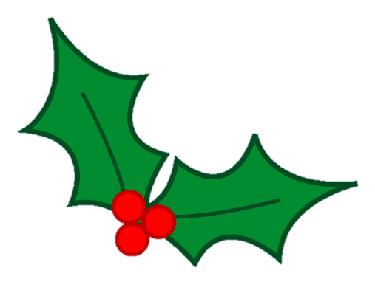
Fitness Advent Calendar
Welcome to the Leeds North West Schools Fitness Advent Calendar
Each day throughout December you will be working a little bit harder than the day before
Can you complete the challenge?

Slide 2
10 arm circles
9 jumps as high as you can
10
9
4 Lunges
2 Sit-Ups
11 Mountain Climbs
12 Star jumps
4
2
11
5 Frog Jumps
12
5
6 Press Ups
8 Bunny Hops
6
8
1 Star Jump
3 Squats
7 Toe Touches
3
7
1

Slide 3
15 Seconds Plank
22 Stand up sit down
15
22
16s Wall Sit
18 Squats
21 Punches with each arm
18
19 Lunges
16
21
23 laps around your chair
19
23
17 Burpees
20 Hops on each leg
24 Repetitions of your favourite activity
17
20
13s Jogging on the spot
14 High Knees
24
13
14

